Slide 1
Employee Attrition Analysis
MSDS-6303 Project - CaseStudy2
Presenter：
Andrew Peng
Date:
2022.12.11

Slide 2

Summary
Objectives
01
Approach
02
03
Modeling and Prediction
Conclusion
04

Slide 3
Objectives
01
Understanding Attrition:
Intestate the data and determine the top 3 factors contributing to turnover
Identify Job Specific Trends:
Find trends specific to different job level to provide insight for executives
Explore Interesting Trends:
Research

Slide 4

Approach
02
Data Summary
Data Cleaning/Processing
EDA
Determine Contributing Factors
Notes:
How do I approach this project?
Give Basic Data Summary
Perform data manipulation to check and verify my assumptions
Perform EDA(Exploratory Data Analysis
Determine the top 3 factors causing attrition

Slide 5
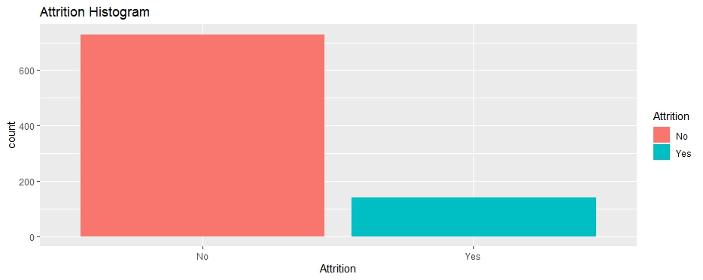
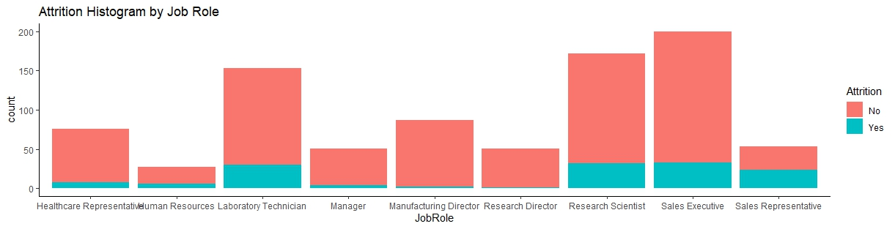
Data Summary
Observation: 870 (740 Stayed| 140 Attrition)
Variables: 36
Categorical: 9
Numeric: 27
Attrition Rate:
Imbalance dataset: 140/870 = 16%
No missing values

Slide 6
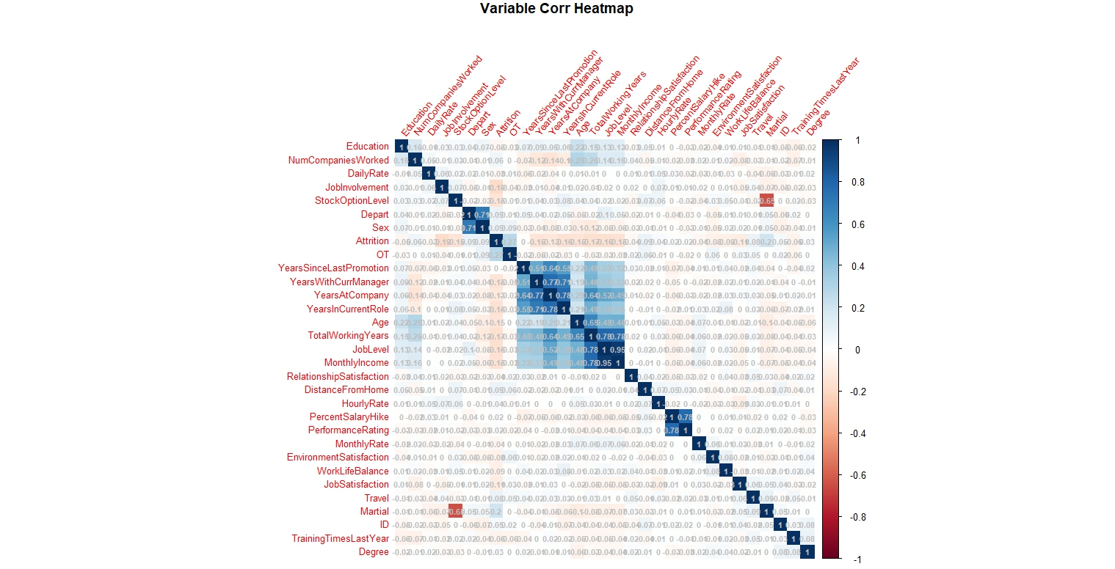
Data Cleaning/Processing:
Covert all variables into factor and examine the correction between all variables
Variables that have high correlation could have impact on the response individually

Slide 7
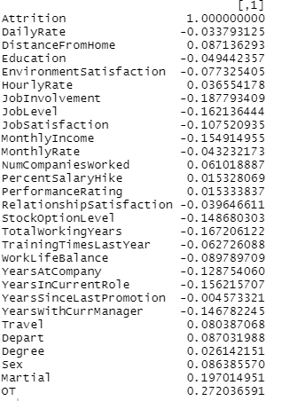

EDA
The correlation data between Attrition and other variables are show list on the left.
Top 3 Factors are:
Overtime
Martial Status
Age

Slide 8
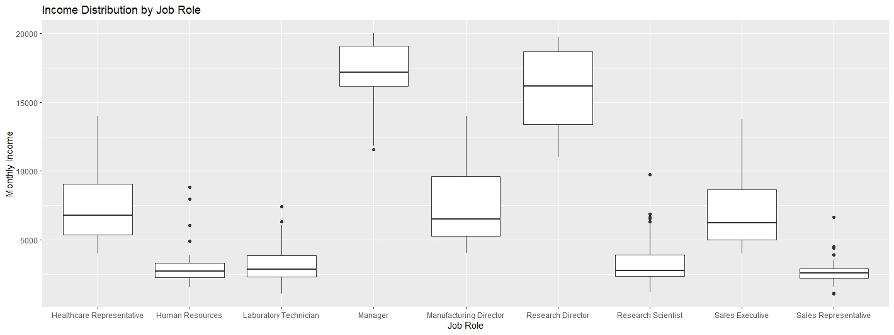
Job Specific Trends:
Manager have the highest mean monthly income followed the Research Director
Human Resources and sales Representatives have the lowest monthly income

Slide 9
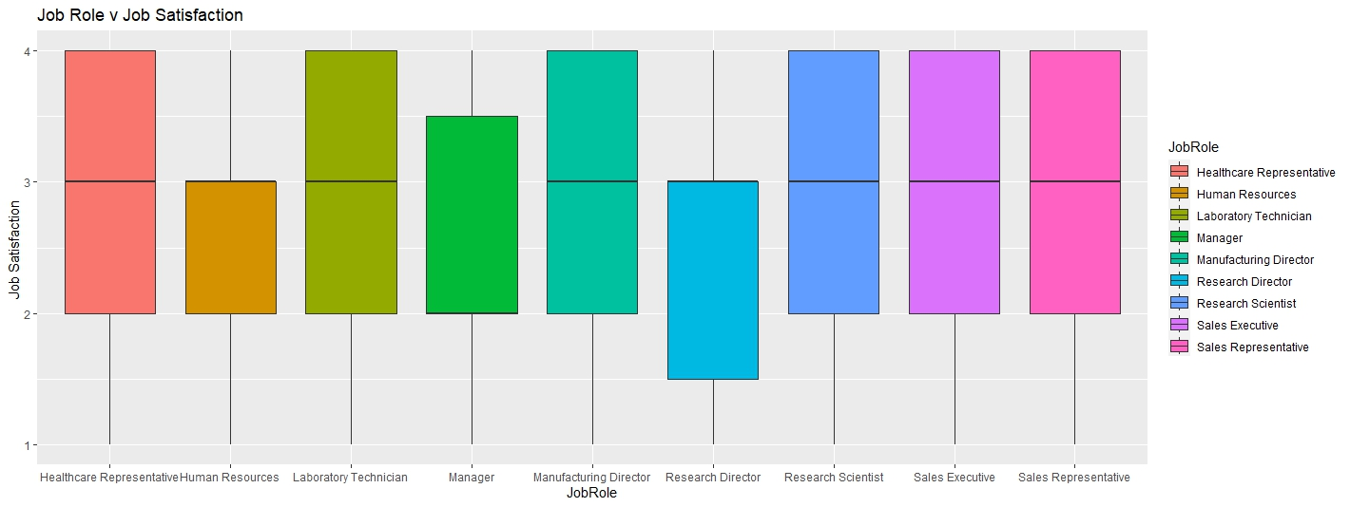
Job Specific Trends:

Slide 10
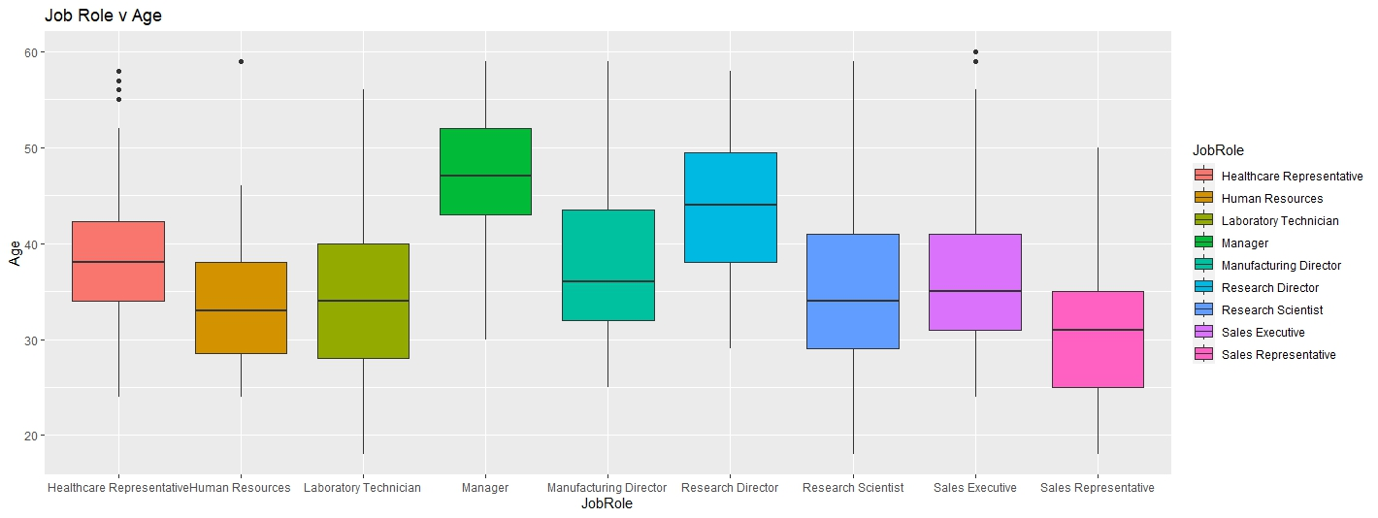
Job Specific Trends:

Slide 11
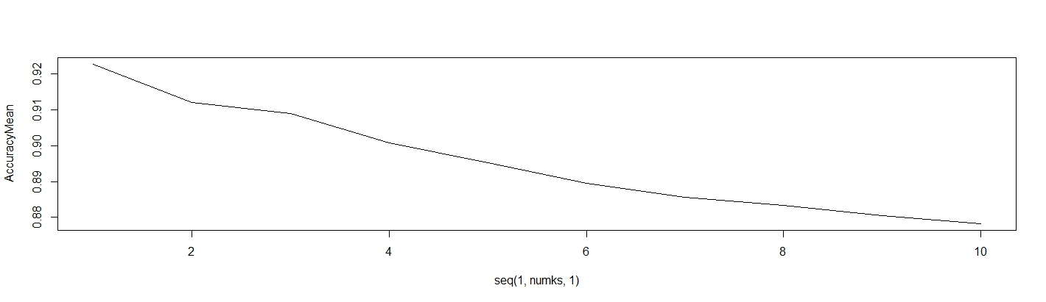
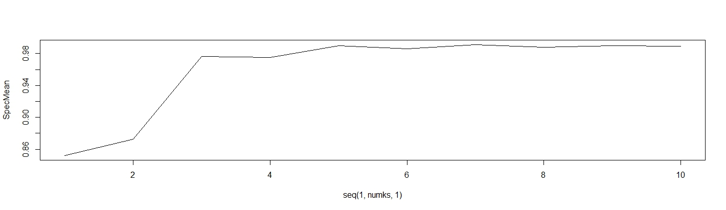
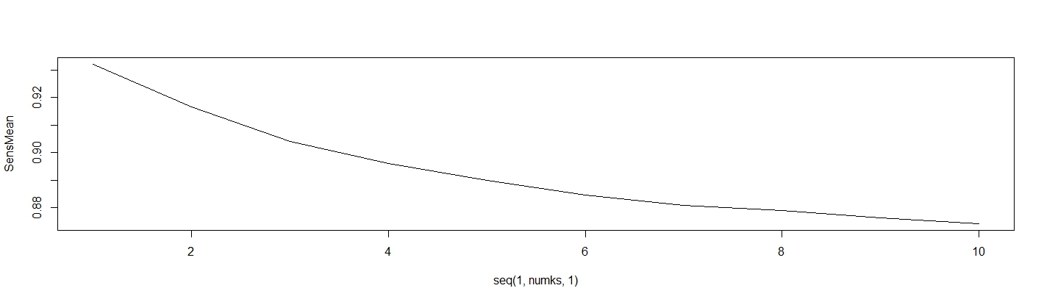
03
Modeling and Prediction
KNN Model
K-Nearest Neighbors Algorithm – a classifier uses proximity to make classifications or predictions about the grouping of an individual data point.
For this model, tested 100 iterations for best fit K values on a 70/30 split of data.
Accuracy = 92.27%
Specificity = 99.11%
Sensitivity = 93.21%

Slide 12
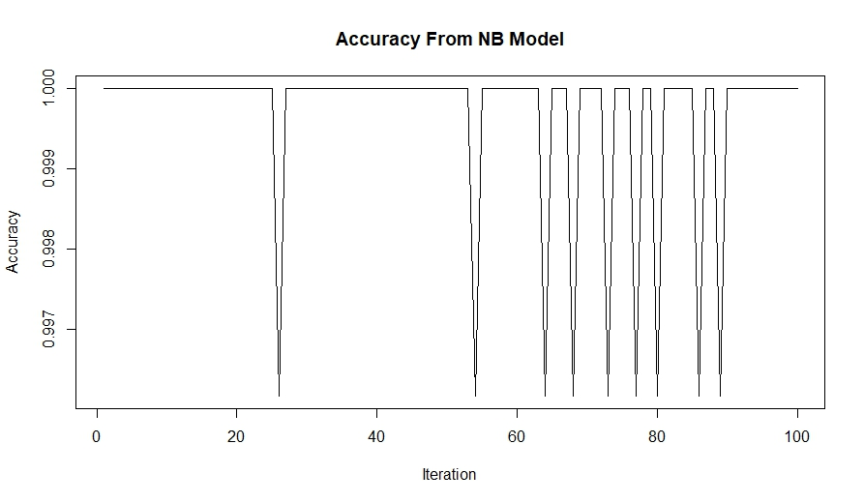
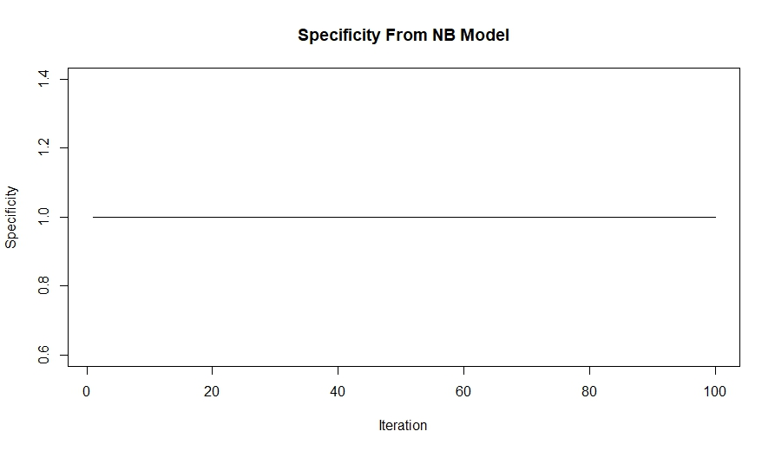
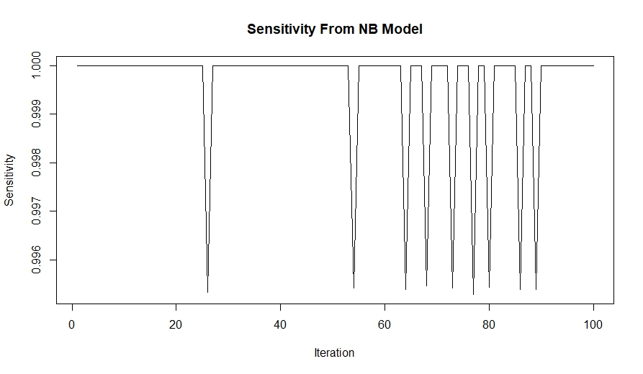
03
Modeling and Prediction
Naive Bayes Model
Naive Bayes Model – a classifier applying Bayes' theorem with strong (naive) independence assumptions between the features.
Accuracy = 99.97%
Specificity = 100%
Sensitivity = 99.96%
Prediction Model for Attrition:
The results from the “Competition Set” for classifying Attrition are provided for your review in a file named “Case2PredictionsPeng Attrition.csv”

Slide 13

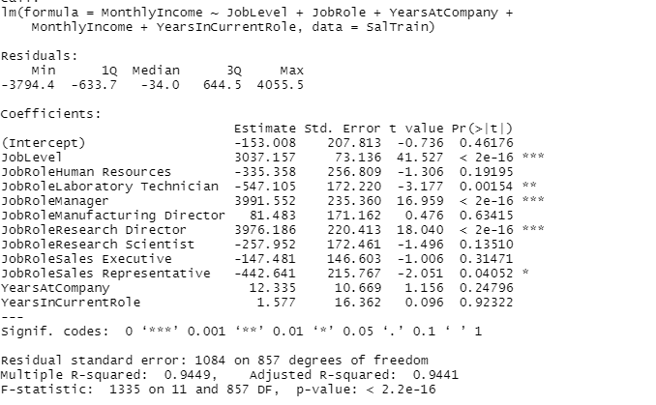
Prediction Model for Salary:
RMSE = 1145.198
The results from the “Competition Set” for classifying Salaray are provided for your review in a file named “Case2PredictionsPeng Salary.csv”

Slide 14
Conclusion
04
Top 3 factors contributing to Attrition: Overtime, Martial Status, and Age
KNN and Naïve Bayes models both worked well. Reasons can be further examined
Job Specific trends are explored with boxplot
Additional model can be built to predict factors such as salary

